Slide 1

SMART LED STAGE LIGHTS
Presented by:
Jahnavi Bhaskara Gowri
Justin Jose
Rana M. Faheem
Shakil M. Tariq

Slide 2
MOTIVATION
Available devices are bulky
Used in larger industries
Frequency and intensity components

Slide 3
AGENDA
Project idea
Goals
Features
Project flow
Challenges and troubleshooting
Limitations
Applications
Summary

Slide 4
IDEA
Convert sound function to light function
Sound input through microphone
Input processed using Raspberry Pi
Varying light output displayed on LED light array

Slide 5
GOALS
Convert sound to light patterns based on
Frequency
Intensity
Portable device
User-friendly
Intuitive

Slide 6
FEATURES
144 LEDs
Multicoloured output
Light interacts with frequency and amplitude of sound

Slide 7
DEVICE FLOW
Pin 16
Frequency
Bootup
GPIO Input
Light Output
GPIO Input
Change/Restart function
GPIO Input:
Pin 20
Stop
Pin 21
Intensity

Slide 8
SOFTWARE IMPLEMENTATION & MULTIPLE PROCESSING
Start
Wait for GPIO Input
LED Function
Update Microphone
Update function
Display Output

Slide 9
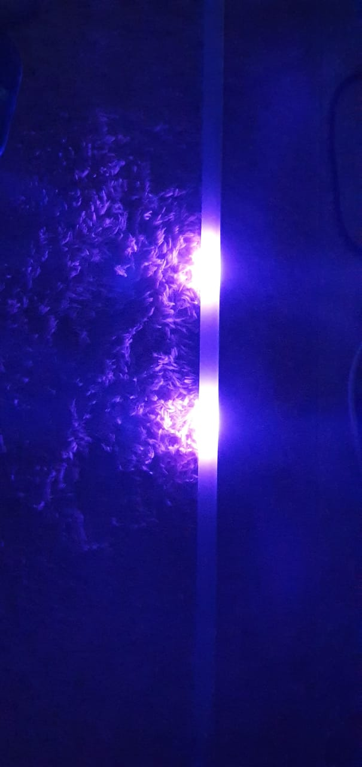
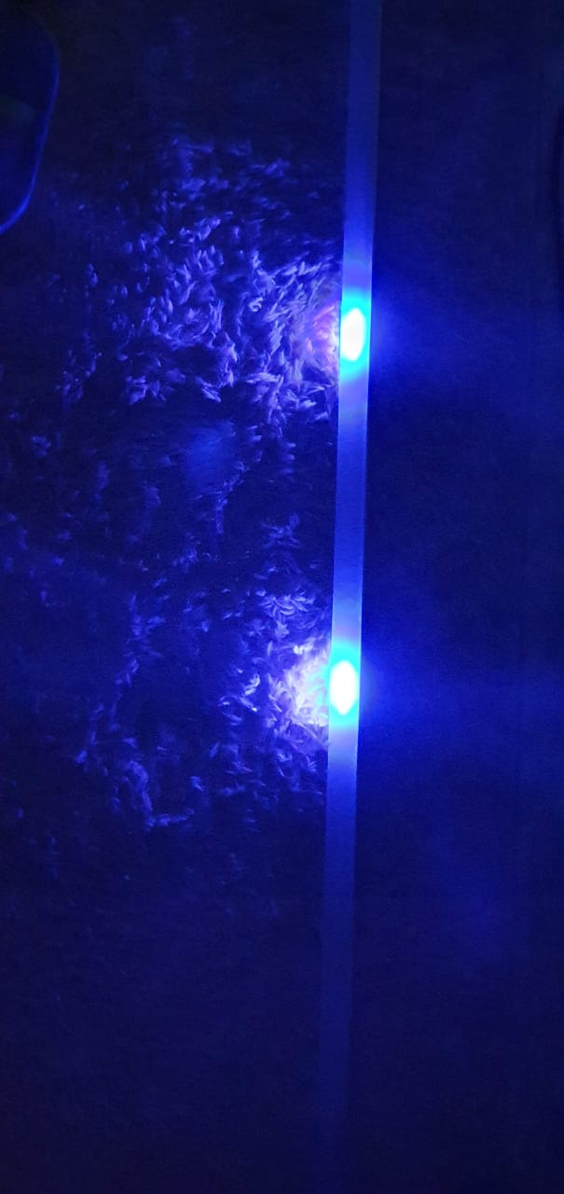
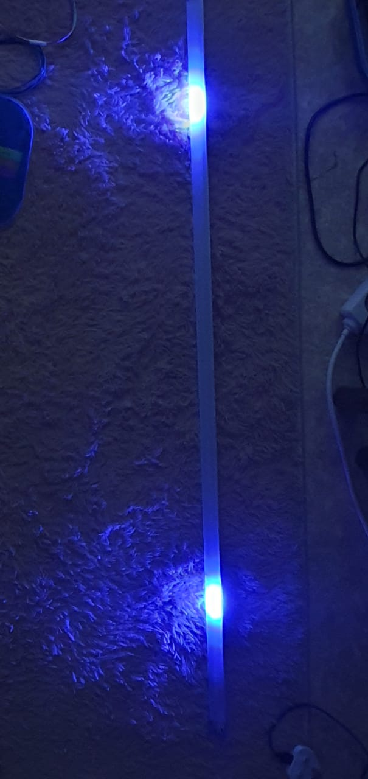
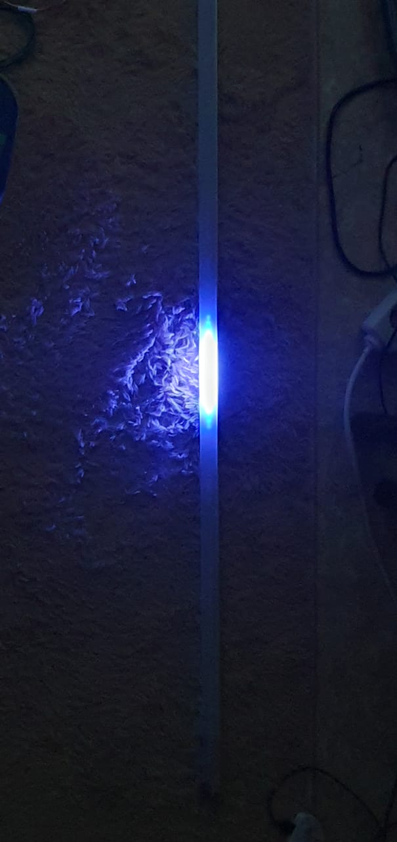
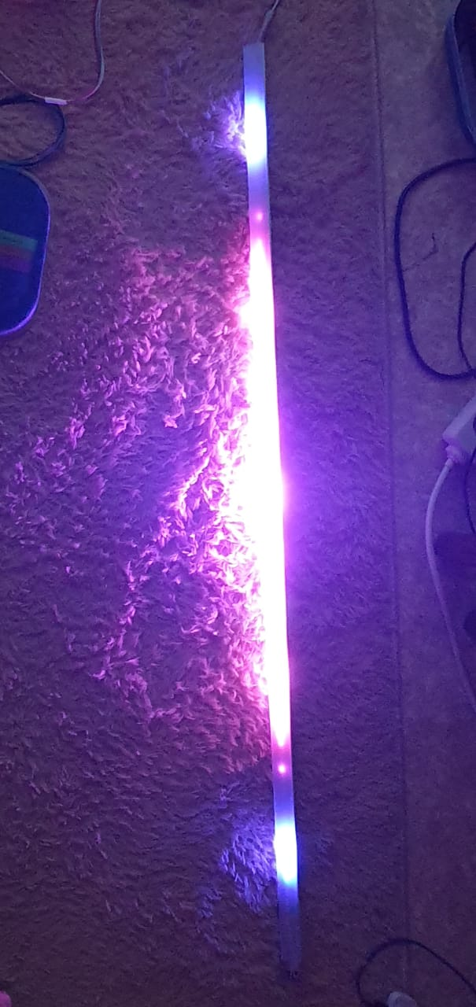
FREQUENCY AND INTENSITY TESTING
1000Hz
1700Hz
5000Hz
Low intensity
High intensity

Slide 10
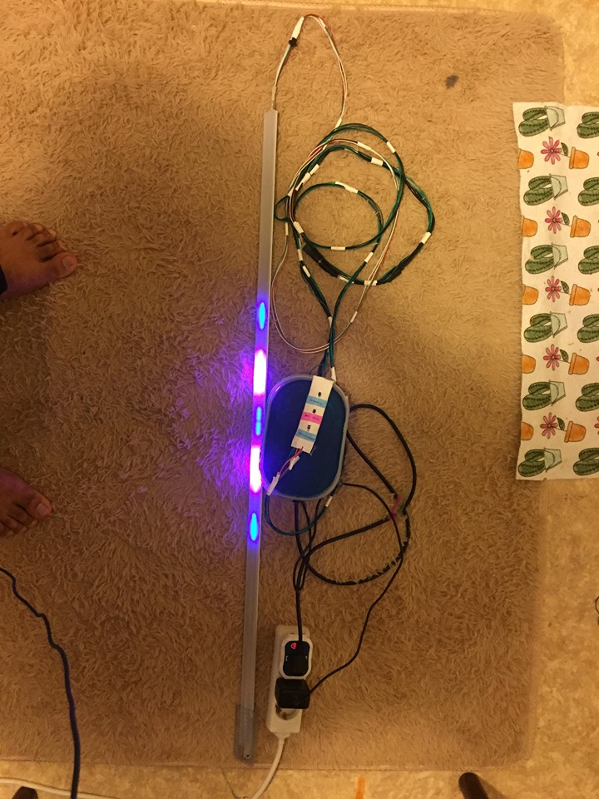
Final Product

Slide 11
CHALLENGES AND TROUBLESHOOTING
Implementation of push buttons to control functions
Debouncing
Controlling the device without external factors
Selection of input power
Configuring mic functions
Adapting GPIO buttons and altering the program flow
Service starts immediately
Calculation
Disabling internal sound card array

Slide 12
LIMITATIONS
Requires external power supply
Noise threshold
Controls single LED strip
One function at a time
Portability

Slide 13
APPLICATION
Theatre
Club
Home decorators
Entertainment industry
Gaming

Slide 14
COST ANALYSIS
COMPONENT | PRICE(EUR)
LED Strip | 22.47
Strip case | 11
Raspberry Pi 3B+ | 40
USB Mic | 6.4
Breadboard + connectors | 7
Total | 86.87

Slide 15
SUMMARY
Project Idea
Functionality
Goals
Project Flow
Challenges and Troubleshooting
Limitation
Applications

Slide 16
REFERENCES
www.raspberrypi.org
www.python.org
https://github.com/adafruit/Adafruit_NeoPixel
https://github.com/scottlawsonbc
Bradbury, A., & Everard, B. (2014). Learning Python with Raspberry Pi. John Wiley & Sons.
Kim, J., Sun, J., Karashchuk, P., & Jin, B. Real-time LED Music Visualizer.
Jain, S., Vaibhav, A., & Goyal, L. (2014, February). Raspberry Pi based interactive home automation system through E-mail. In 2014 International Conference on Reliability Optimization and Information Technology (ICROIT) (pp. 277-280). IEEE.

Slide 17
THANK YOU!

